Slide 1
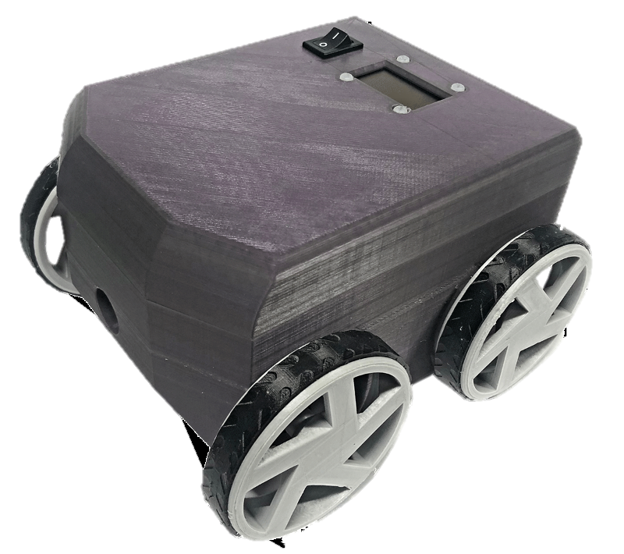
Pytobot
Programming on the go!

Slide 2
Story
As an engineer,
Notes:
I’m not I teacher, my job is to let children explore themselves inside an open invirement

Slide 3


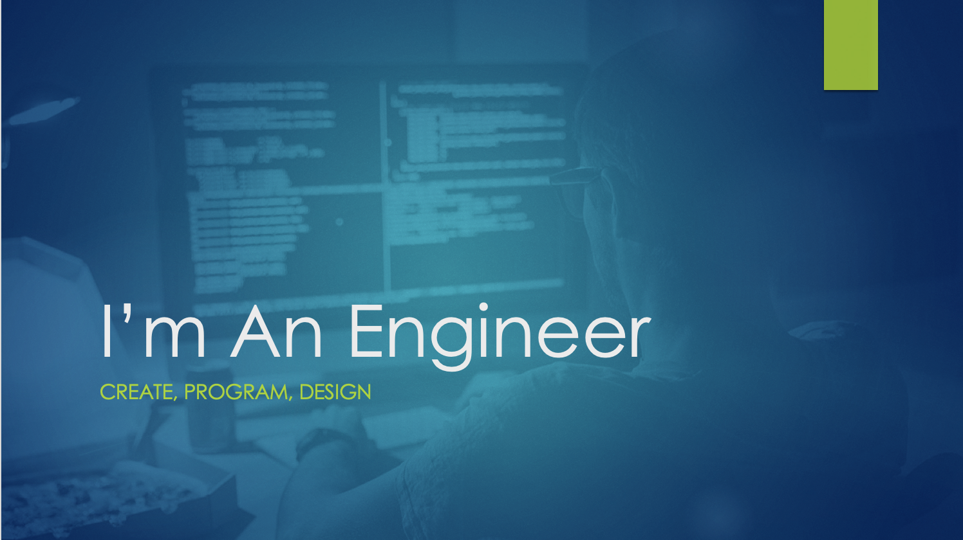

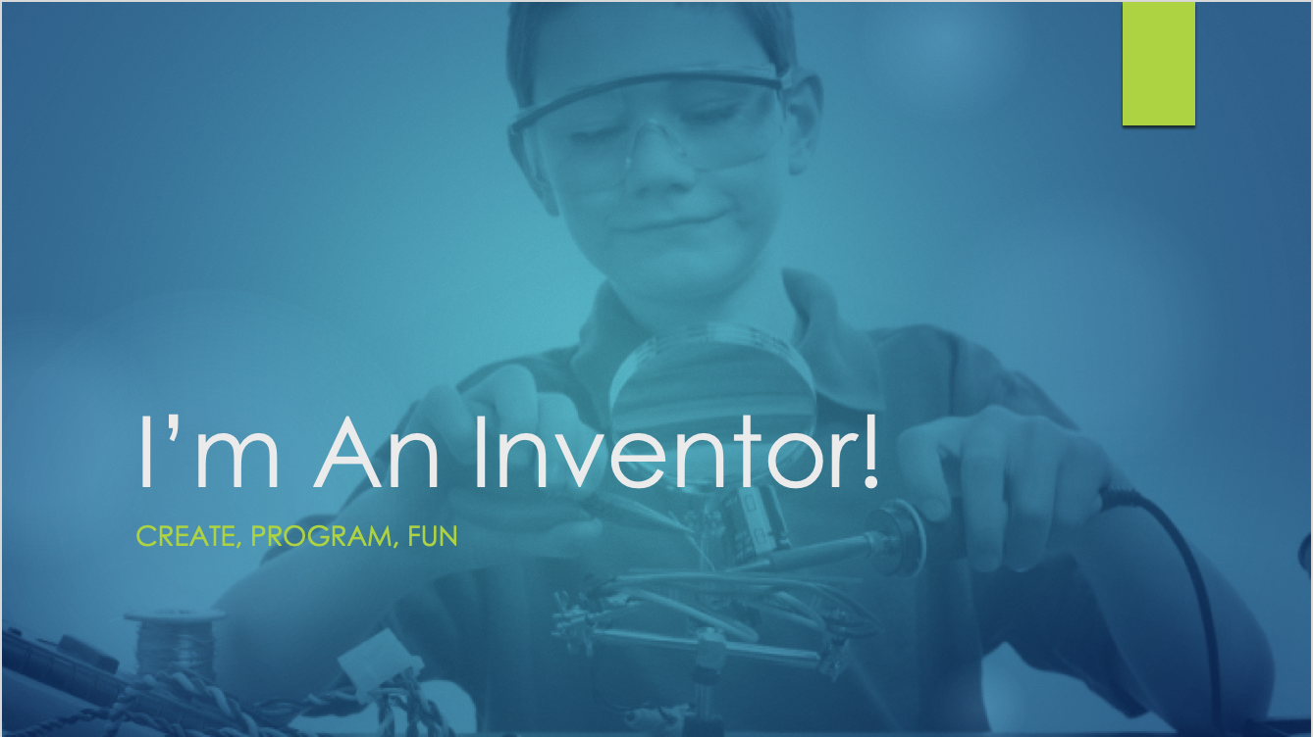



Your level, Your fun

Slide 4

I’m An Engineer
Create, program, Design

Slide 5
I’m A Engineer
Open Source
open community
Linux Operating system

Slide 6
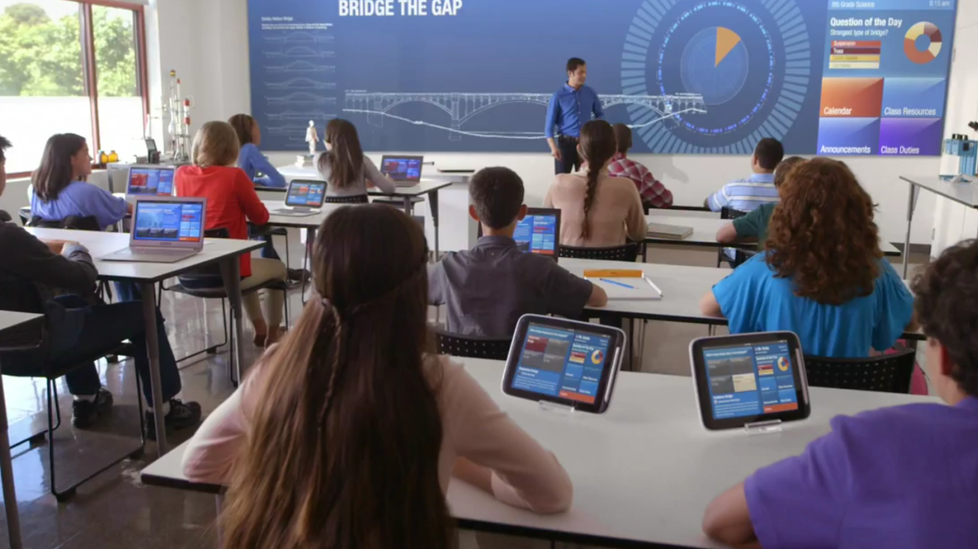
I’m A Teacher
Teach, Create, Learn

Slide 7
I’m a Teacher
New & excitement
Educational package
Teach beyond the classroom

Slide 8
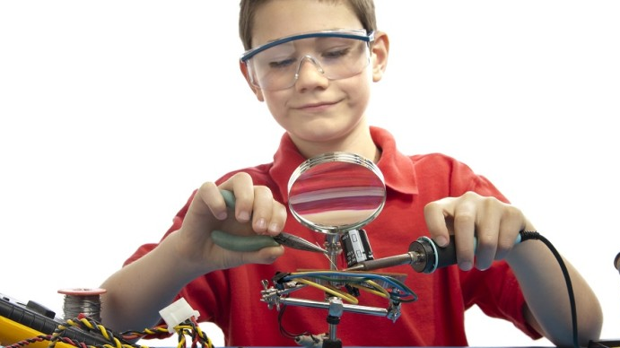
I’m An Inventor!
Create, Program, Learn, enjoy

Slide 9
I’m An Inventor
Robot
Open environment
Unique

Slide 10
Features
Start From Console
Prepared Hardware
Flash SD Card
Remote Control (SSH)
Own hotspot
Open Source Documentation
Available API’s
Online Tutorials
Interactive Programming
Multiple achievements
Different Educational levels
Logical Thinking
Understand of Algorithms
Develop your own car
Full Device Control
Easy Upgradable
From 8 until 18 year old
Teach beyond the classroom
Start From scratch
Open Source Documentation
Order list
Eagle Schematics
STL Files
Community
HTTP communication
Flow Programming
Multi stage learning

Slide 11
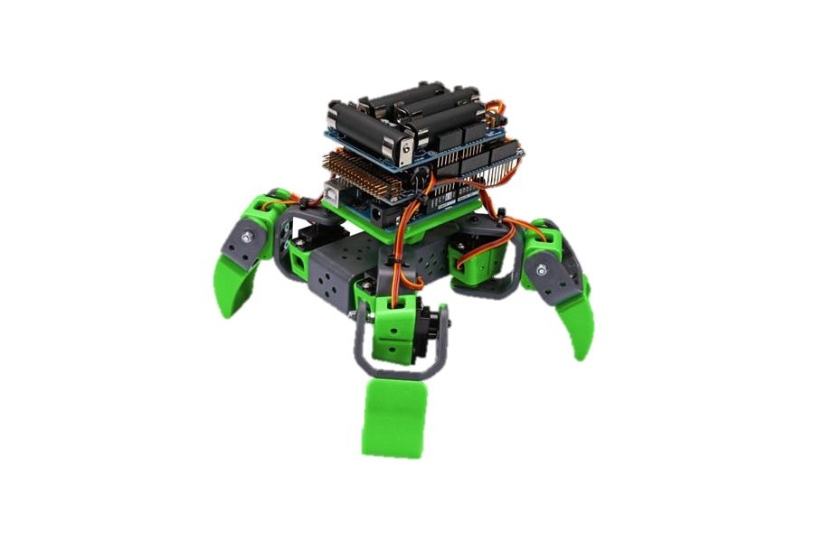
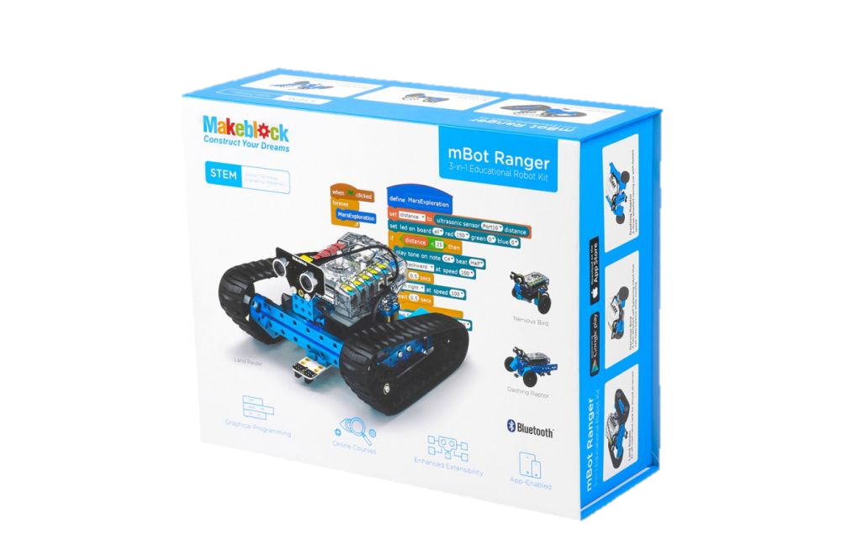
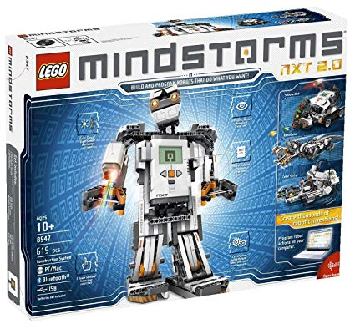
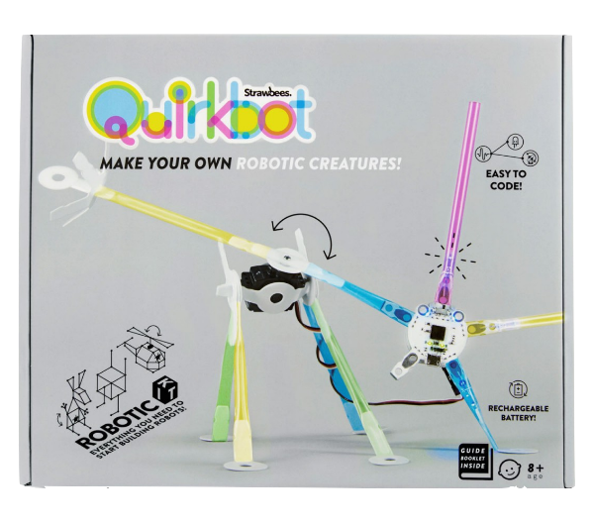
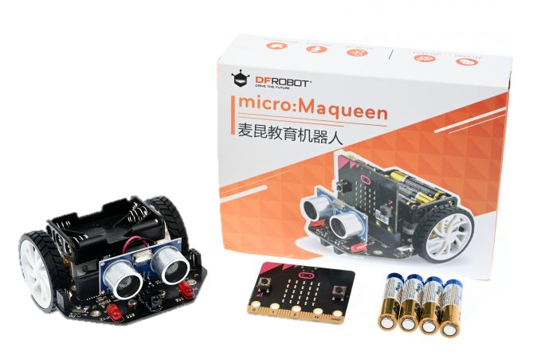
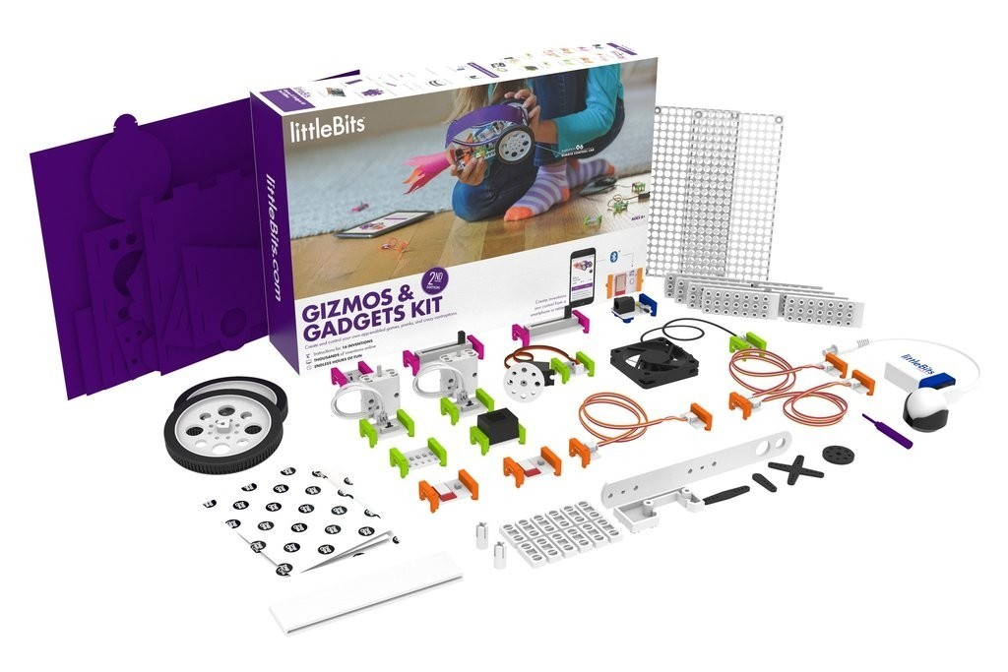
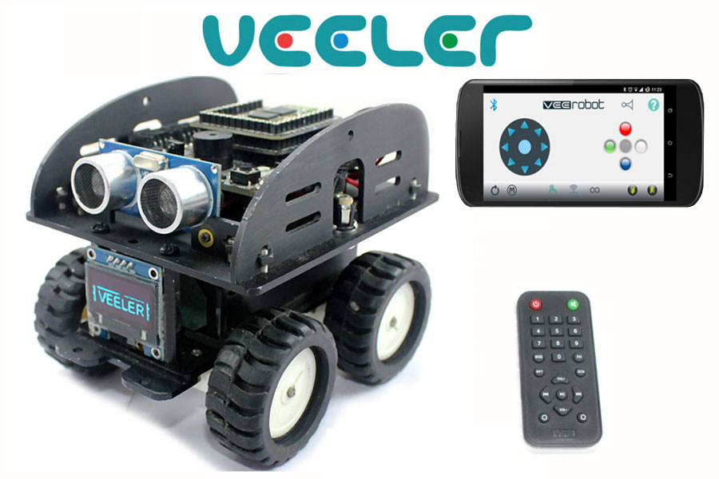
Competition

Slide 12
Experience
Create from scratch
3D-Modeling
Full p

Slide 13
“Tell me and I’ll forget. Show me and I may remember. Involve me and I learn.” - Benjamin Franklin-

Slide 14






Open source

Slide 15
Engineer
Inventor
Teacher
Software & documentation:
Open source community: €0
Hardware & materials:
Basic components: €100
Upgrade: €100 - €250
Total: €100 - €250
Software & documentation:
Open source community: €0
SD Memory chip: €10
Hardware & materials:
Basic package: €120
Extra’s: €5 - €75
Total: €130 - …
Software & documentation:
Open source community: €0
Hardware & materials:
package: €200

